Slide 1

Traffic Patterns
CIS 5200-03
Group 5
Dalyapraz Dauletbak
Wenji Hu
Ritika Joshi
Ketki Vyas

Slide 2

Table of Content
What is Waze
Introduction
Oracle Cluster Specification
Hadoop Specification
Architecture Chart
Implementation of Analysis
Data Specification
Data Cleaning
Visualization
Conclusion

Slide 3
What is Waze
A GPS navigation mobile application
Provide real-time directions and up-to-date information
Traffic
Accidents
Travel obstacles
Gas price
Lurking police vehicles
Notes:
Waze data set is new. - there are no public data sets available. - we got it from someone in person
Using this data set we are going find out the cause of different kinds of alerts and jams in LA. their severity level and number of counts of each cause.

Slide 4

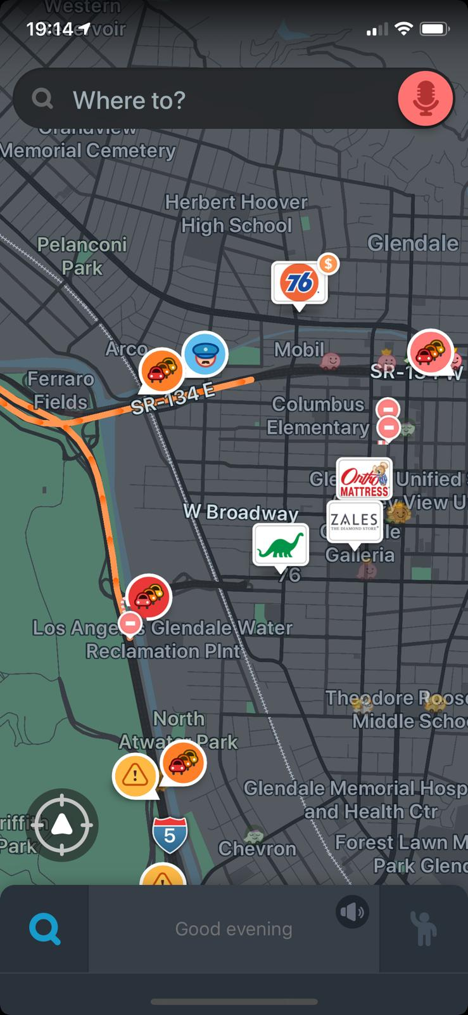
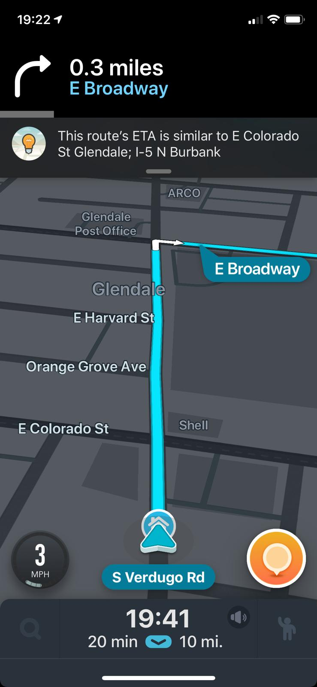
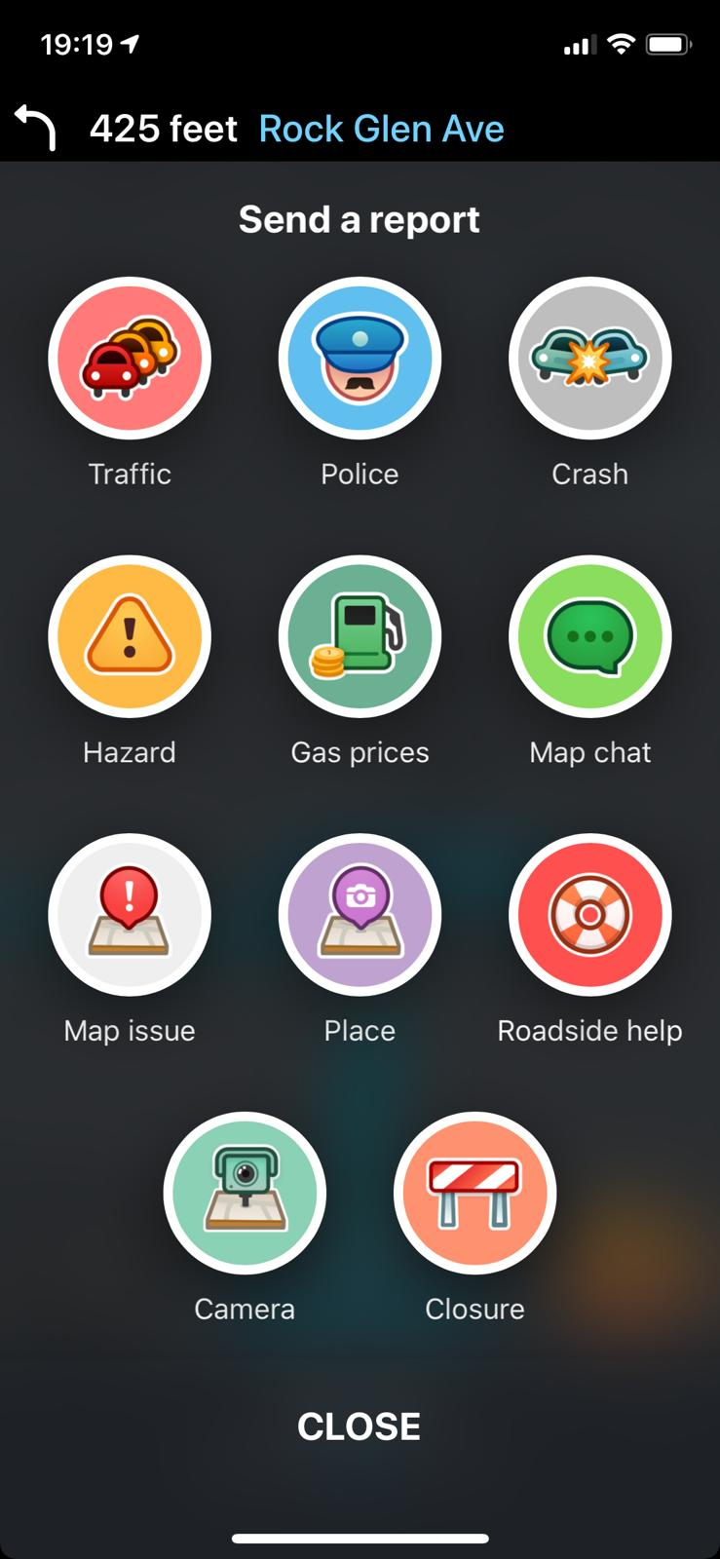
What is Waze
Report
Home Page
Map Page
Navigation Page
Report Page
Notes:
Waze data set is new. - there are no public data sets available. - we got it from someone in person
Using this data set we are going find out the cause of different kinds of alerts and jams in LA. their severity level and number of counts of each cause.

Slide 5
Introduction
Waze traffic data set from LA City department
Actual report from users
Alerts, Jams, Irregularities
We are going to find out:
Areas with high volume of traffic (geography)
Peak-hours
Density of Alerts and Incidents
Traffic volume by road types
Notes:
Waze data set is new. - there are no public data sets available. - we got it from someone in person
Using this data set we are going find out the cause of different kinds of alerts and jams in LA. their severity level and number of counts of each cause.

Slide 6
Data Specifications
URLs:https://github.com/CityOfLosAngeles/aqueduct/blob/master/waze/schema-waze.sql
Data Set | Size(26 MB)
irregularities_head | 19138 KB
jams_head | 2024 KB
alerts_head | 1999 KB

Slide 7
Limitations on Data Set
Waze data from LA City Department
Limited authority to access the full datasets
100 GB+ original, but received 10K rows for each file
Dataset is limited for specific days

Slide 8
Oracle Cluster Specifications
OCPUs | 10
Memory | 150GB
Storage | 678GB
CPU speed | 2195.084 MHz
CPU Model Name | Intel(R) Xeon(R) CPU E5-2699C v4 @ 2.20GHz
Notes:
Hadoop 2.7.1.2.4.2.0-258
Subversion https://orahub.oraclecorp.com/bigdata-compute-bdcsce/bigtop-release.git -r ef18ece7fde04ac06ff77753e96ec308f83b66e8
Hive 1.2.1000.2.4.2.0-258
Subversion git://05035c7c8e55/ws/build/hive/rpm/BUILD/apache-hive-1.2.1-src -r 7910eaca2dbb6c2702f1cec12532f6f42415c97b

Slide 9
Hadoop Specifications
Hadoop Cluster version | Hadoop 2.7.1.2.4.2.0-258
Hive version | Hive 1.2.1000.2.4.2.0-258
Number of nodes | 5
HDFS Capacity | 147 GB
Notes:
Hadoop 2.7.1.2.4.2.0-258
Subversion https://orahub.oraclecorp.com/bigdata-compute-bdcsce/bigtop-release.git -r ef18ece7fde04ac06ff77753e96ec308f83b66e8
Hive 1.2.1000.2.4.2.0-258
Subversion git://05035c7c8e55/ws/build/hive/rpm/BUILD/apache-hive-1.2.1-src -r 7910eaca2dbb6c2702f1cec12532f6f42415c97b

Slide 10

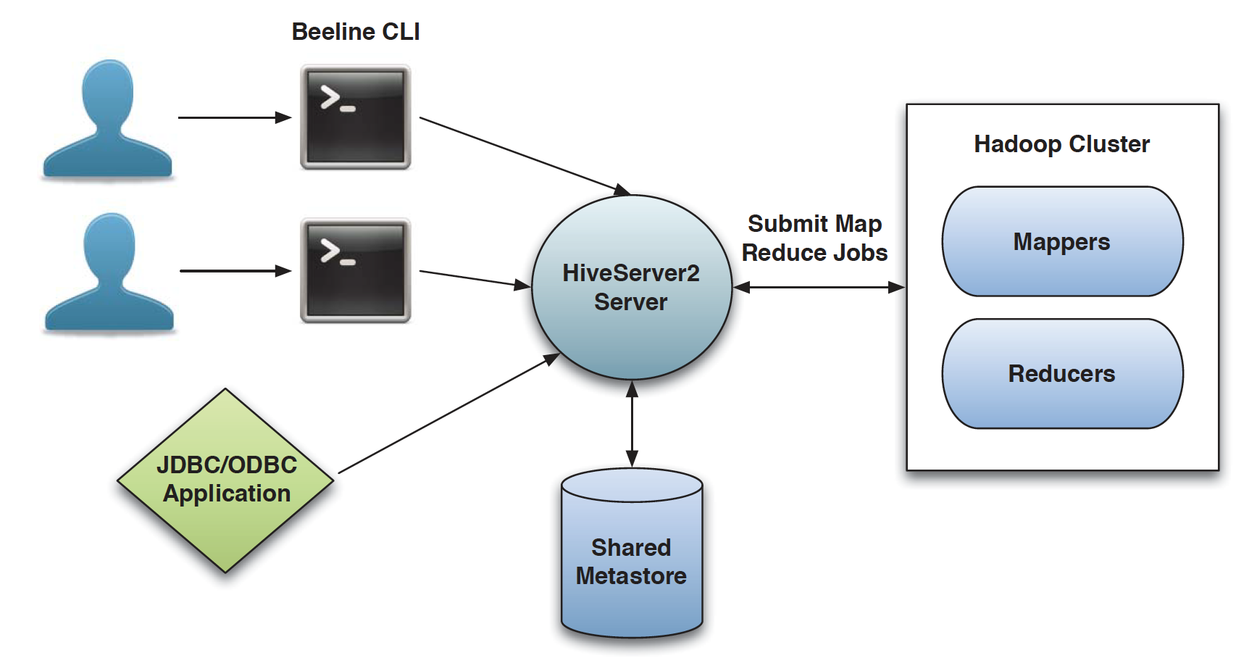
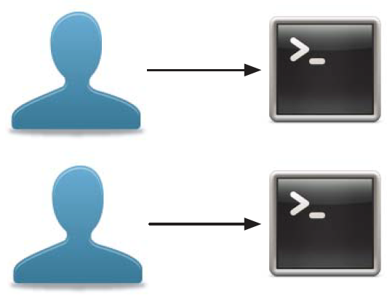
Architecture Chart

Slide 11
Implementation Flow Chart
Download raw dataset
Upload dataset to HDFS
Create table on Hive
Clean data
Visualize data
Export results
Create summary table

Slide 12
Implementation of Analysis
Step 1
Downloaded the raw csv data files
Uploaded the csv files from local to server
Step 2
Step 3
Loaded the csv files into HDFS
Step 4
Created tables’ schema using HiveQL

Slide 13
Implementation of Analysis (Cont’d)
Step 5
Cleaned data by using HiveQL
Step 6
Created summary table for analysis
Exported results into csv files for further analysis in BI tools
Step 7
Step 8
Visualized data using Excel and Power BI

Slide 14

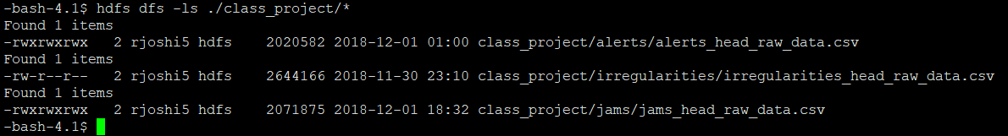
The Raw Files
alerts_head_raw_data.csv
irregularities_head_raw_data.csv
jams_head_raw_data.csv

Slide 15
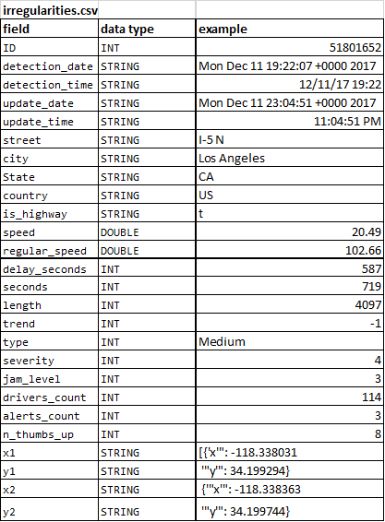
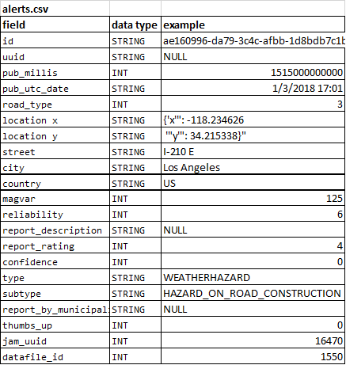
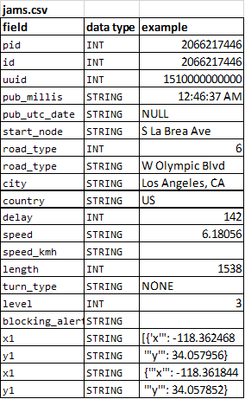
Data structure (Raw files)

Slide 16
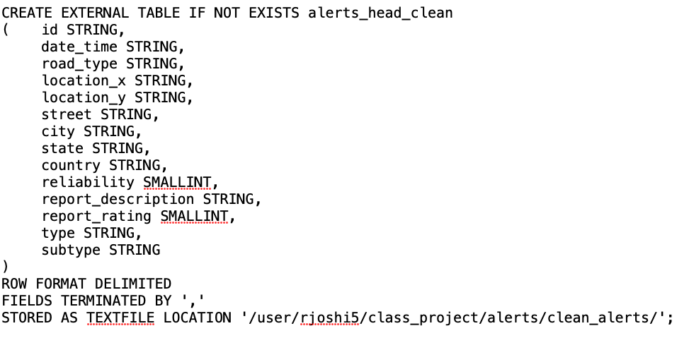
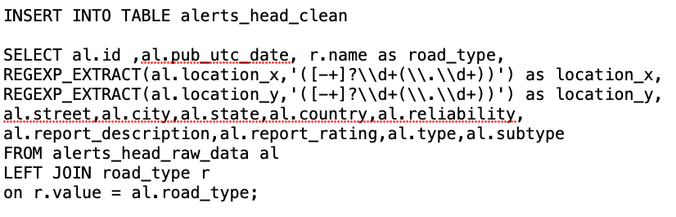
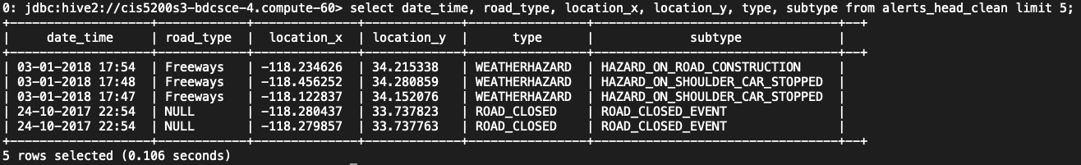
Data Cleaning

Slide 17
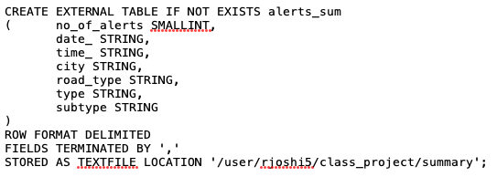
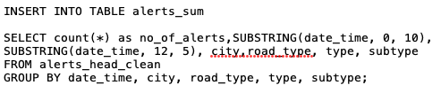
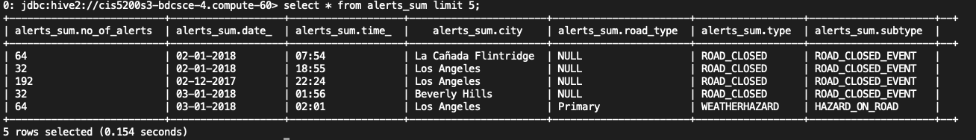
Summary data

Slide 18
Visualization
Information we are using:
Location/Time
Level of traffic intensity
X and Y coordinates (Longitude & Latitude)
Counts of jams and alerts
Tools we are using:
Excel - 3D map
Power BI - Flow map, pie charts, bar charts

Slide 19
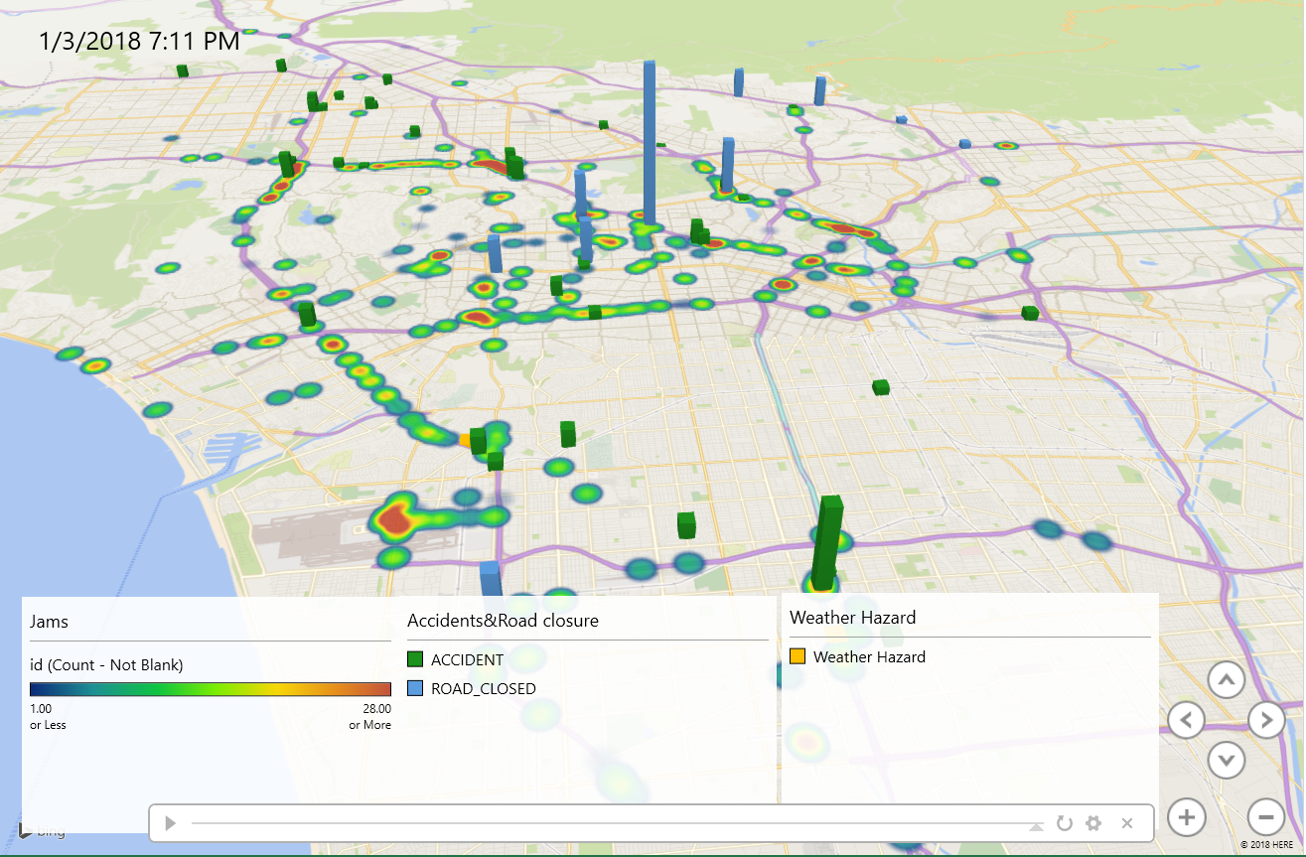
3D Map on Excel Alerts and Accidents (1/2/2018)

Slide 20

3D Map on Excel through Timeline (1/2/2018)

Slide 21
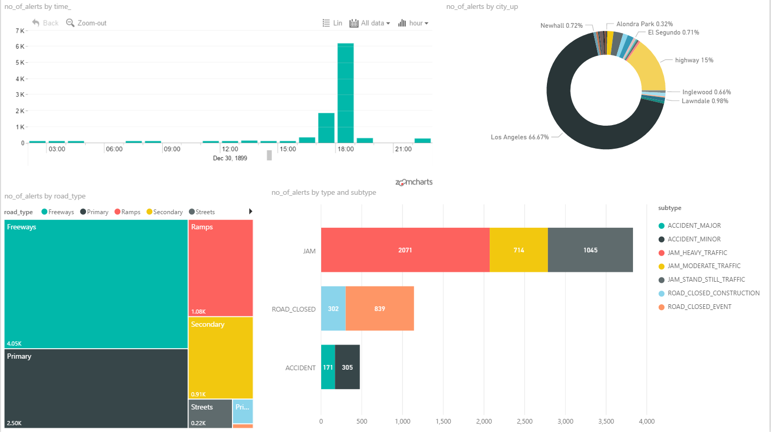
Alerts in LA County - Dashboard

Slide 22
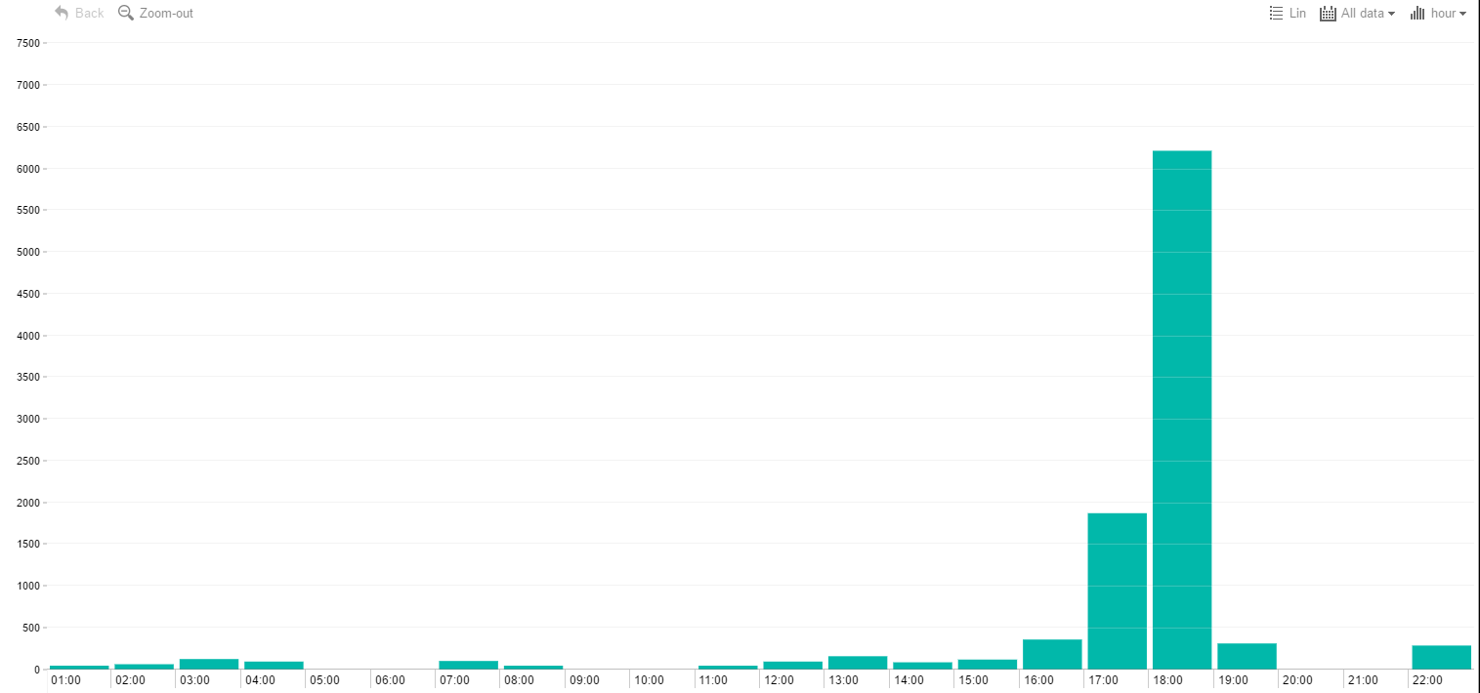
Number of Alerts by Time
Peak-hour

Slide 23
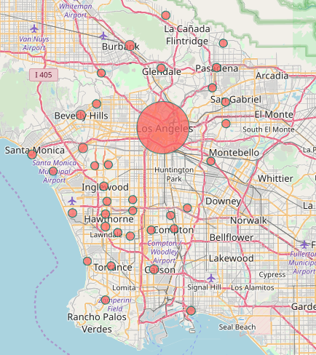
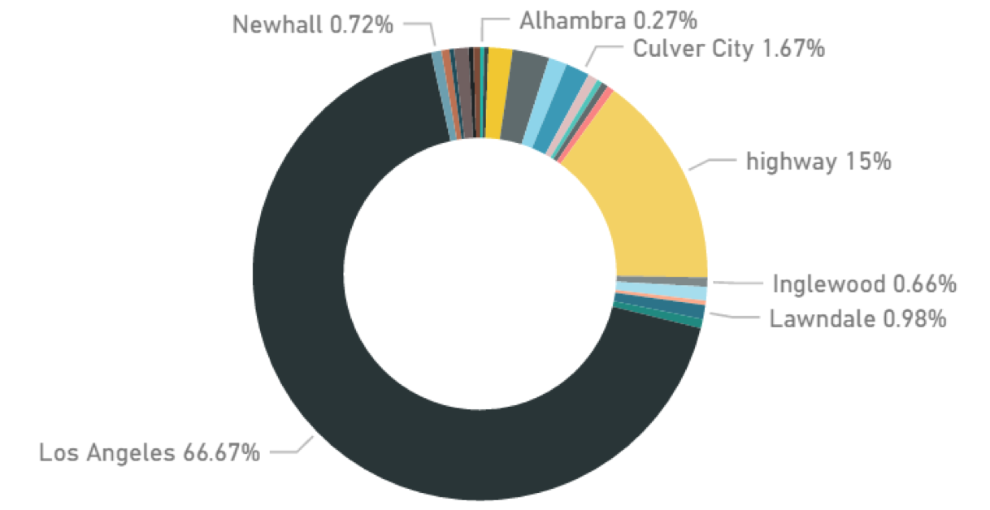
Number of Alerts by City in LA County

Slide 24
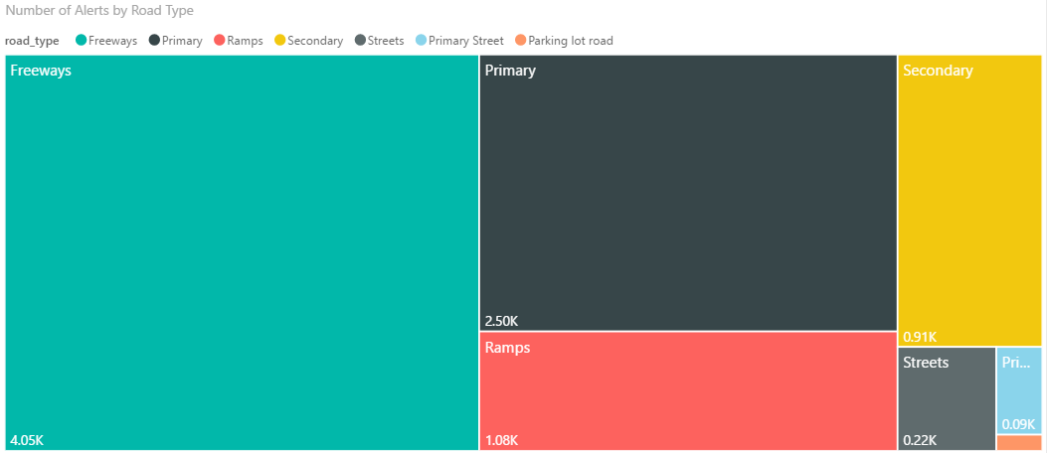
Number of Alerts by Road Types

Slide 25
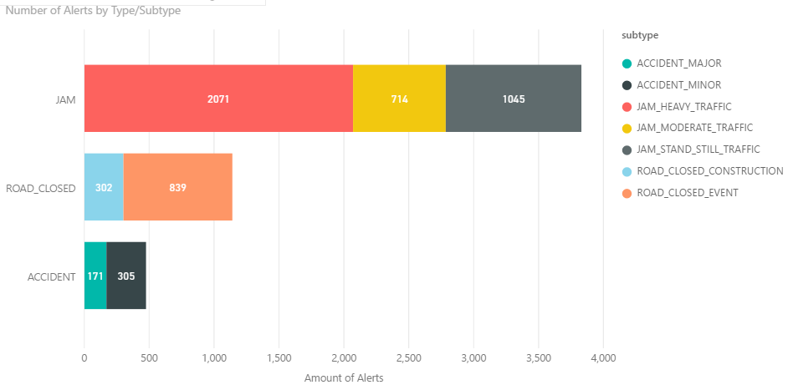
Amount of Alerts by Types/Subtypes

Slide 26
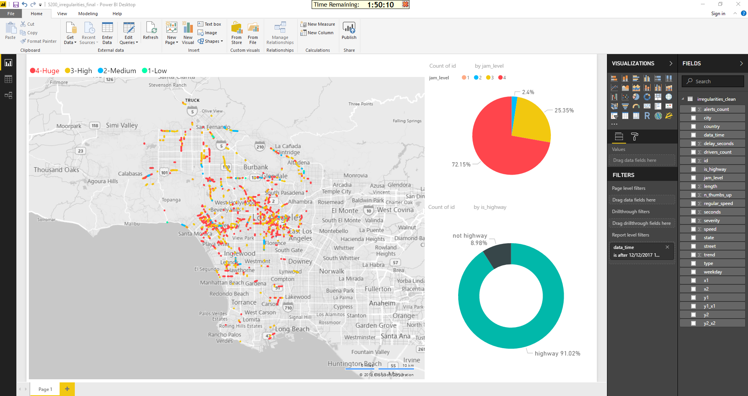
Traffic Jams - Dashboard

Slide 27
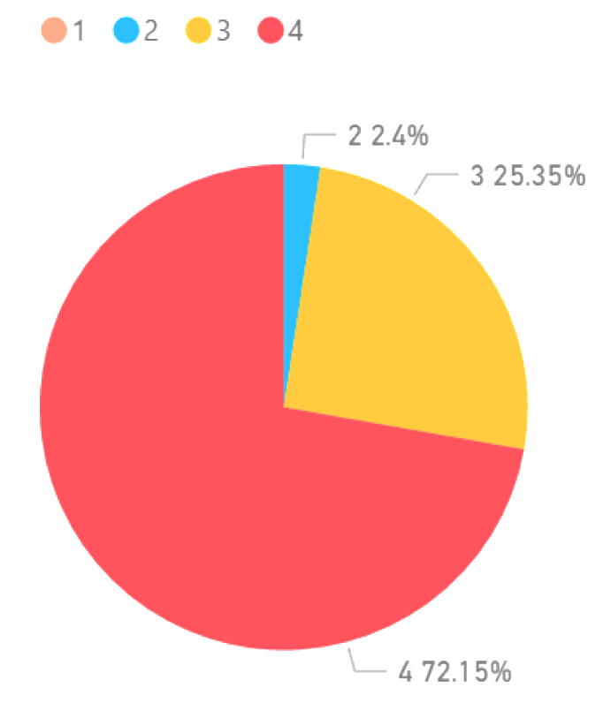
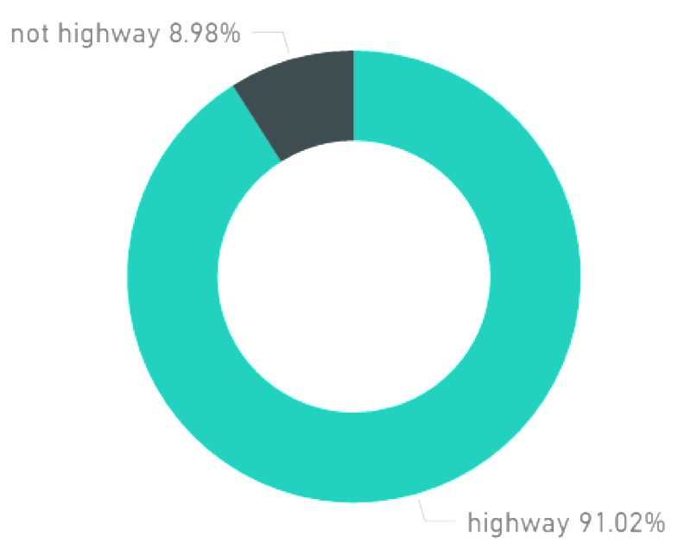
Jams by Levels and Street Types
__________Jam Level (1-4)___ _ __
_Amount of Jams on Street Types_

Slide 28
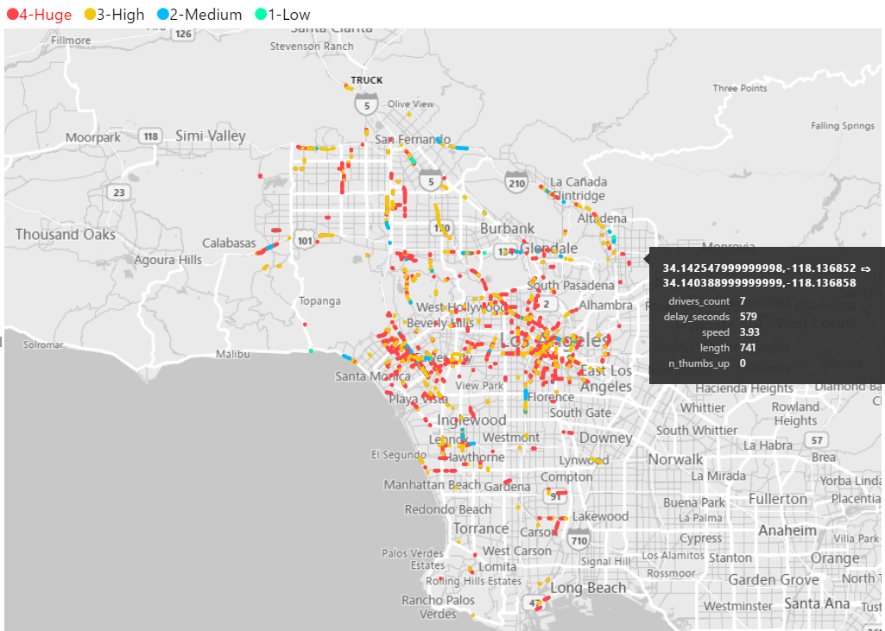
Traffic Jams Patterns in LA County
Notes:
Talk about density near Santa monica, Hollywood and DTLA

Slide 29
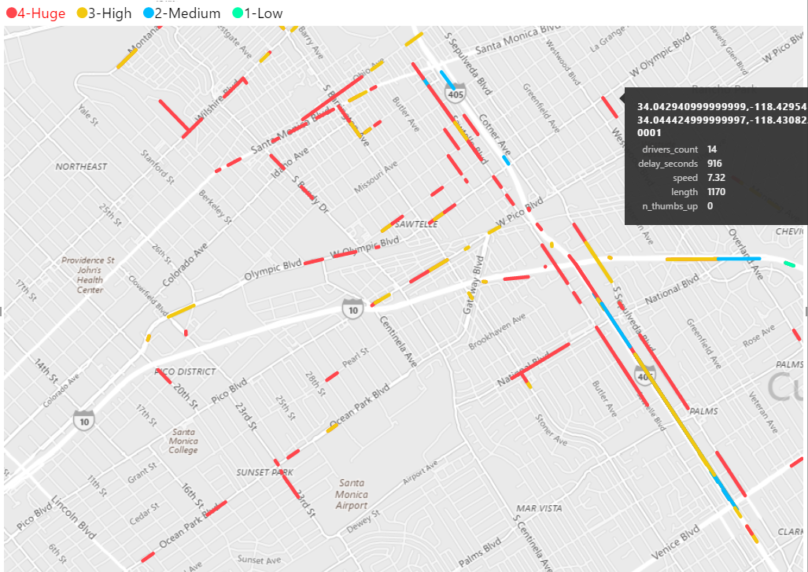
Traffic Jams in Santa Monica (Close up)

Slide 30
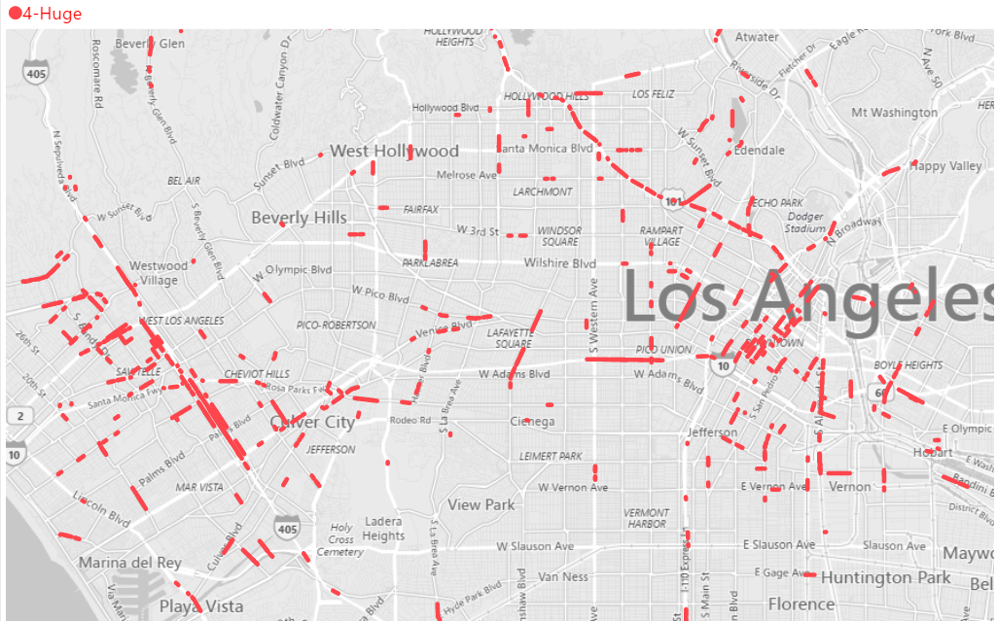
Traffic Jams in LA County for Level-4 (out of 4)
Notes:
Talk about intensity on highways (101), (405)

Slide 31
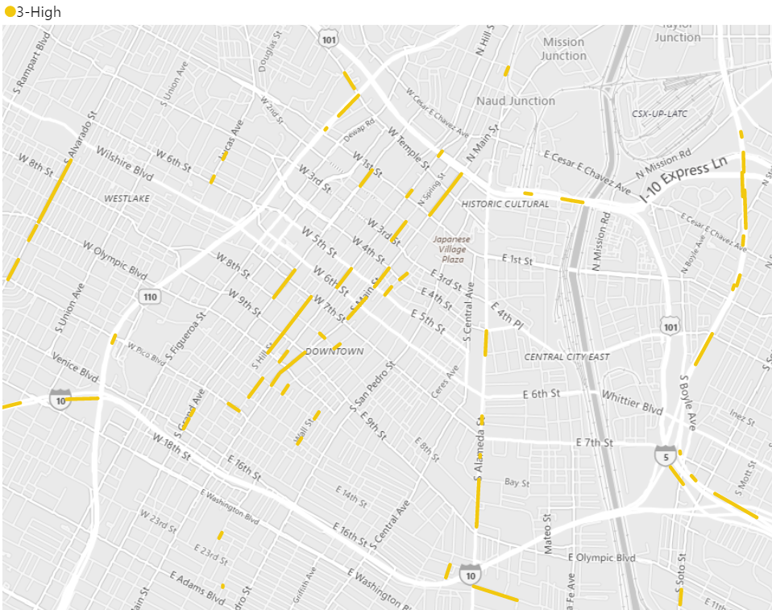
Traffic Jams in DTLA for Level-3(out of 4)
Notes:
Talk about surprisingly lower level of jams then expected and that jams are concentrated in West part of DTLA where all the offices are situated (Banks, etc)

Slide 32
Conclusion
Dense traffic on highways
Evening time is the heaviest traffic time
Major areas of traffic in DTLA, Santa Monica, Hollywood
More insights can be found with bigger dataset using this framework for analysis of traffic

Slide 33

GitHub Link
https://github.com/rjoshi5/waze_traffic_patterns_LosAngeles
Scripts
Dataset schema
Deliverable visuals
Documents
Presentation

